Slide 1
Employee Data Analysis using Excel
STUDENT NAME : SHAHINA BEGUM B
REGISTER NO : 312208421 (asunm1330312208421)
DEPARTMENT : B.COM ACCOUNTING / FINANACE
COLLEGE : CHELLAMMAL WOMEN’S
COLLEGE

Slide 2
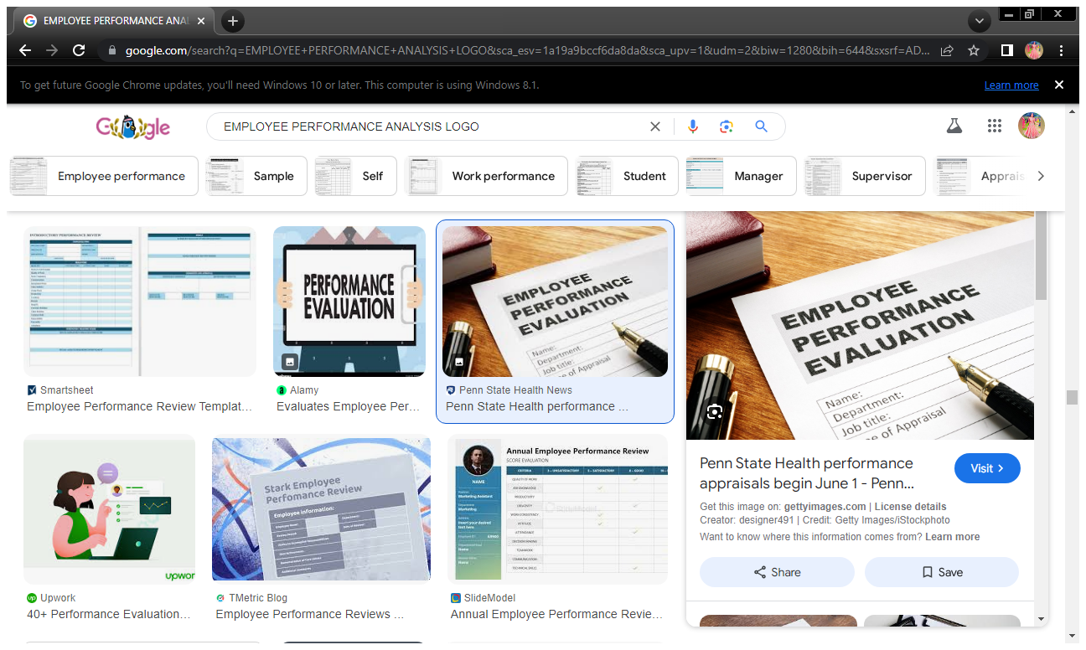
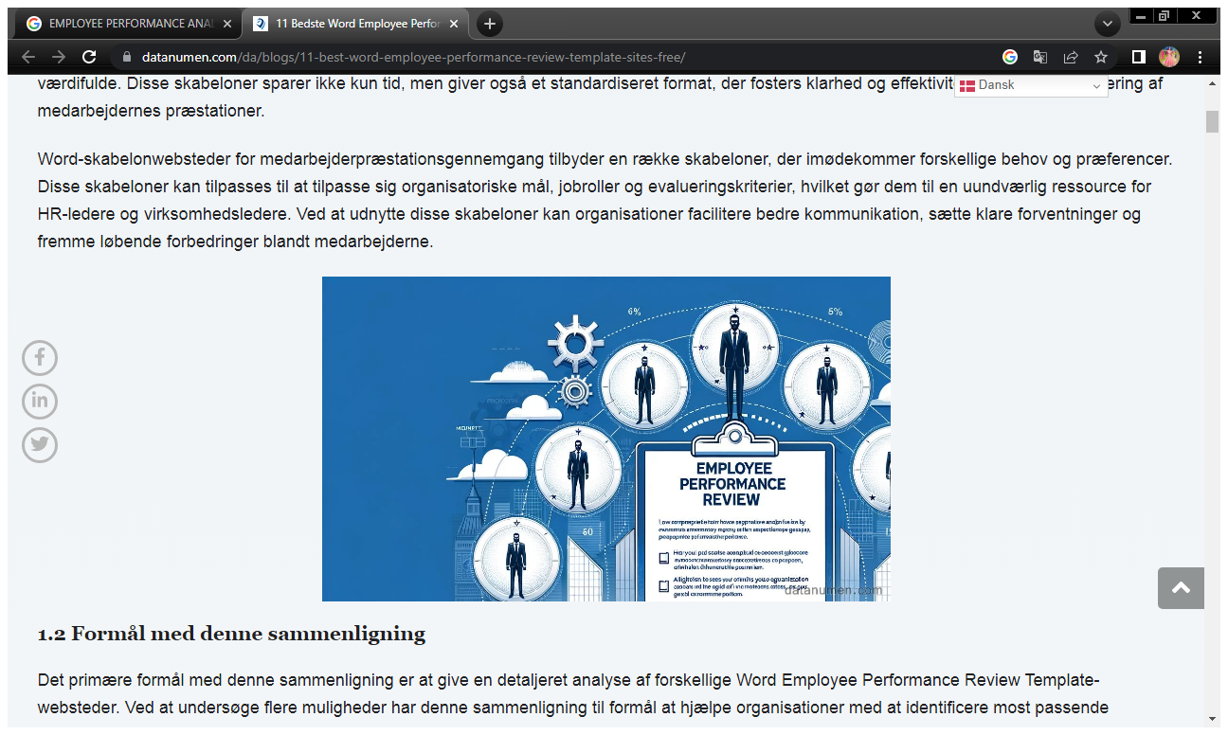
Employee Performance Analysis using Excel

Slide 3
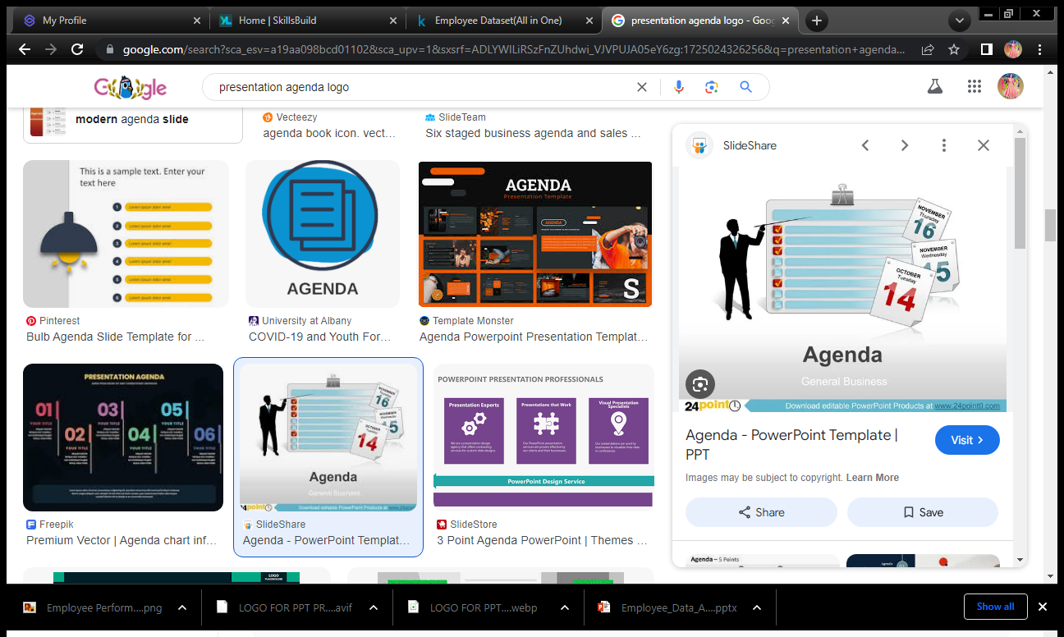
AGENDA
Problem Statement.
Project Overview.
End Users.
Our Solution and Proposition.
Dataset Description.
Modelling Approach.
Results and Discussion.
Conclusion.

Slide 4
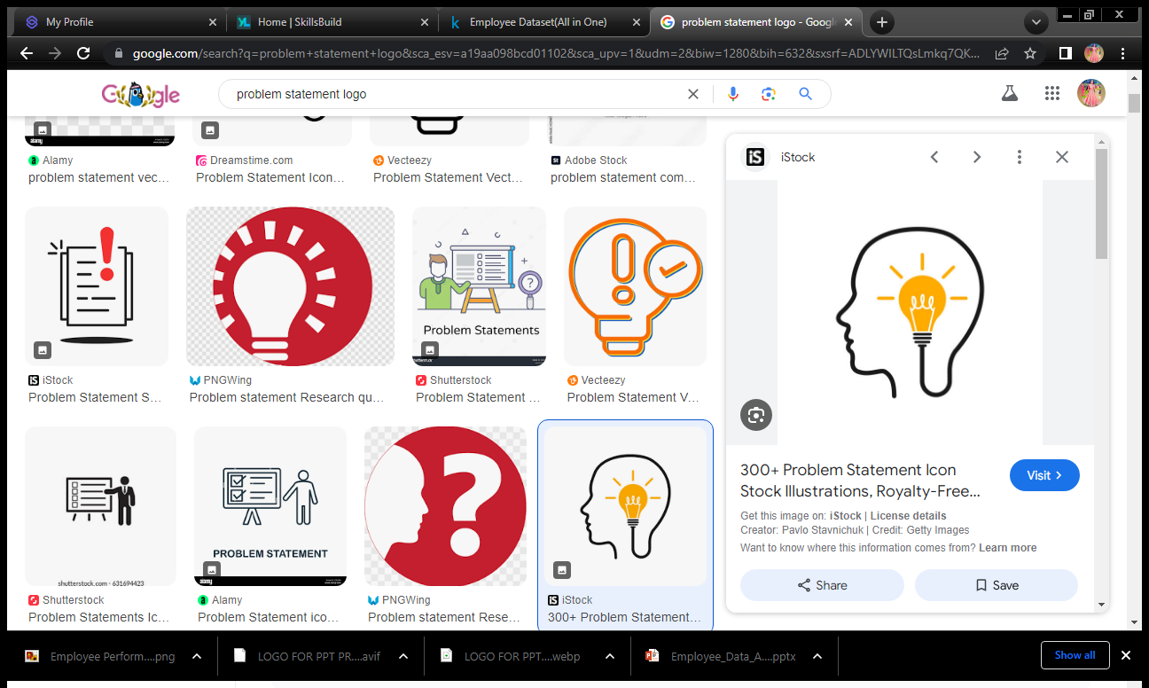

PROBLEM STATEMENT
Identify root causes of performance decline.
Implement improvement strategies.
Monitor and evaluate progress.
Enhance employee training programs to address skill gaps.
Improve management practices to foster workflows.
Conduct regular feedback sessions to continuously improve performance supportive work environment.
Increase employee motivation through recognition and reward systems.
Implement technology solutions to streamline.

Slide 5
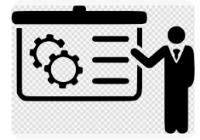
PROJECT OVERVIEW
Employee Performance Analysis :
Analyzing the performance of the employee by considering various factors like gender, performance code, ratings and their achievements. in order to identify the trends and patens of different categories of employees like high, medium and low.
Objective :
To enhance employee performance by identifying and addressing key factors affecting productivity, quality of work and engagement.
Scope :
Collect and analyze data from performance reviews, surveys, and interviews to identify root causes of performance issues. implement improvement strategies and monitor their effectiveness.

Slide 6

WHO ARE THE END USERS?
Board Of Directors.
Management and Leadership.
Human Resources(HR).
Employees.
Team Leaders and Supervisors.
Training and Development.
Executives.
Project Managers.
Finance Department.
IT Department.
Operations Managers.
Sales and Marketing teams.

Slide 7
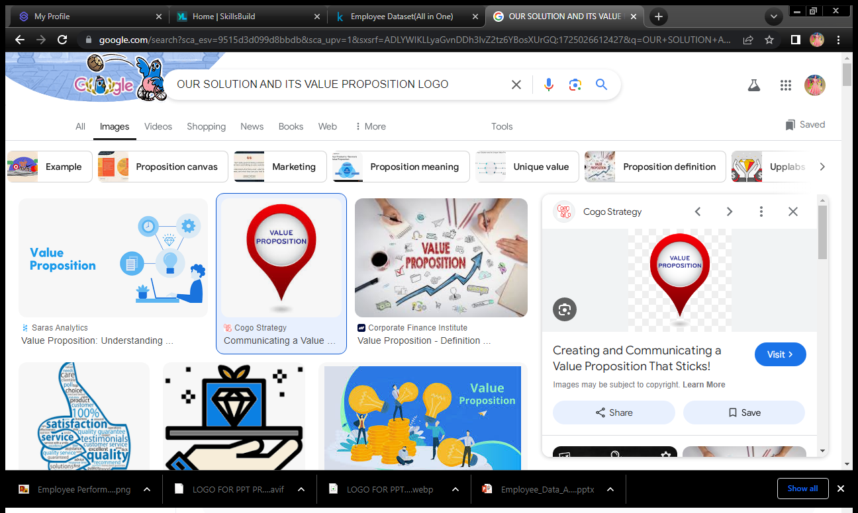
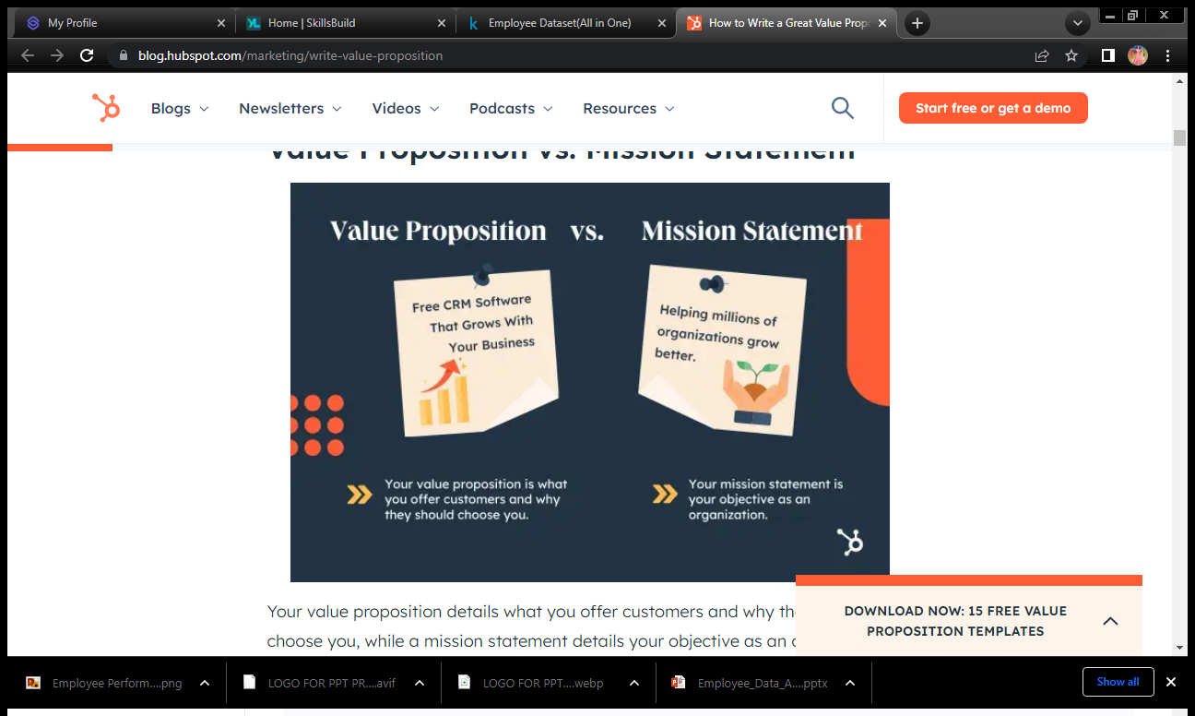
OUR SOLUTION AND ITS VALUE PROPOSITION
Conditional formatting → Missing.
Filter → Remove.
Formula → Performance.
Pivot table → Summary.
Graph → Data Visualization.

Slide 8

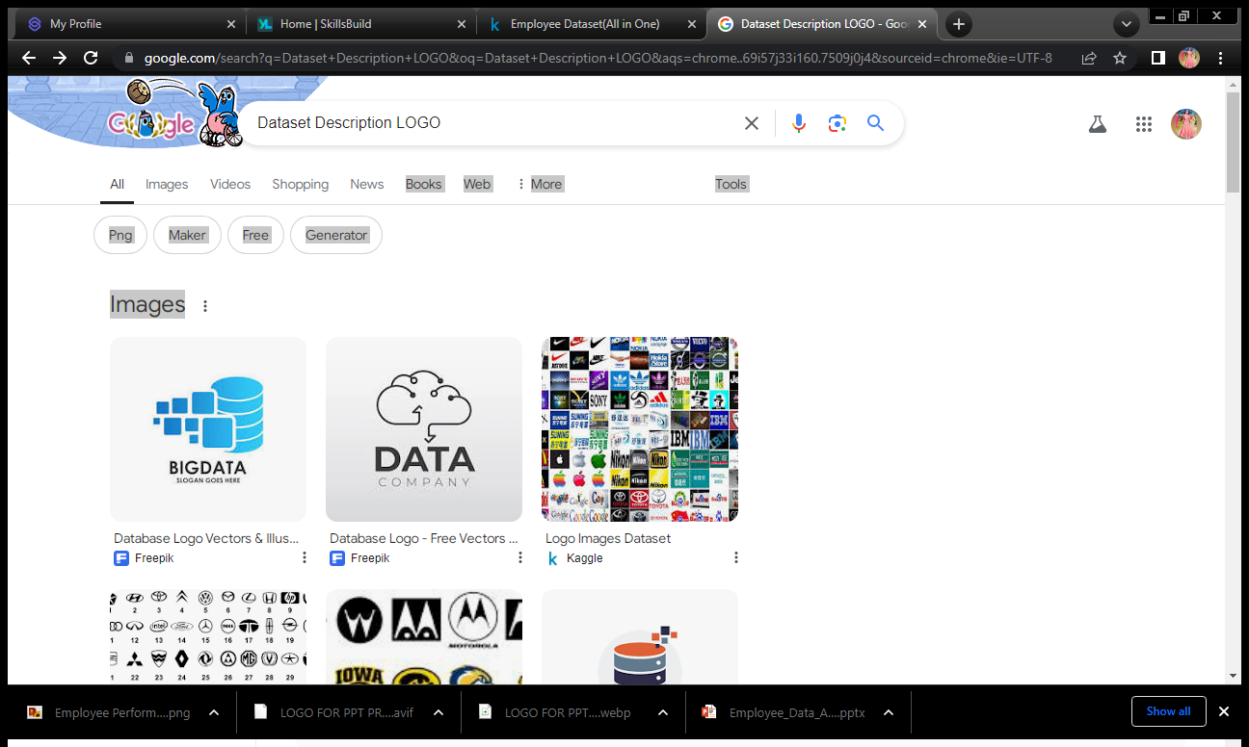
DATASET DESCRIPTION
Employee dataset → kaggle.
26 features available → 9 features used.
Employee ID → Numerical.
Employee name → Text.
Employee type → Roles.
Performance level → High, Medium and Low.
Gender → Male and Female.
Employee rating → Numerical.

Slide 9
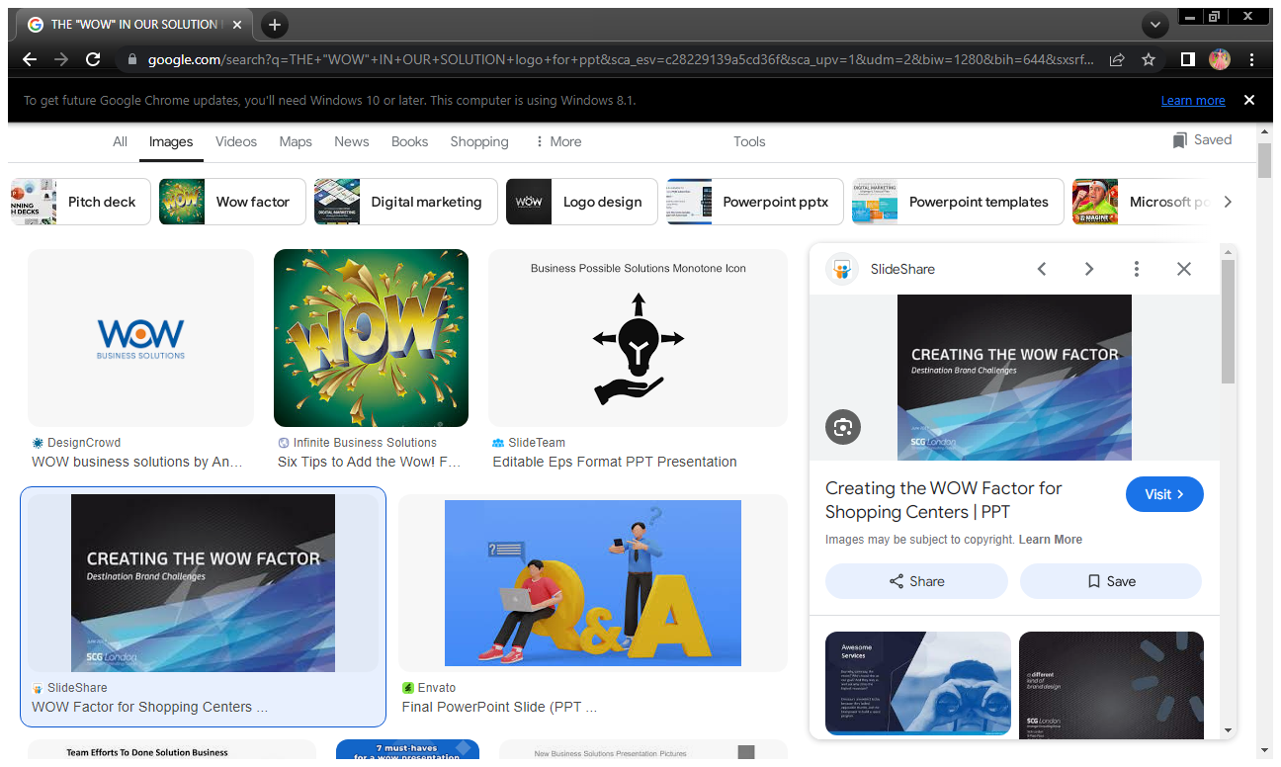
THE "WOW" IN OUR SOLUTION
Conditional formatting
→ Identifying missing data.
Filter
→ To remove blank cells.
Performance level
→ =IFS(logical_test1,value_if_true,[logical_test2,value_if_true2],…)
→ =IFS(Z8>=5,”VERY HIGH”,Z8>=4,”HIGH”,Z8>=3,MEDIUM”,TRUE,”LOW)
Summary
→ Pivot table.
Data visualization
→ Graph : column chart with trend line.
3/21/2024 Annual Review
9

Slide 10
Data collection
MODELLING
Performance level
Dataset from kaggle.
Data selection.
Calculation of performance level.
Performance Level → ifs(z8>=5,”very high”,z8>=4,”high”,z8>=3,medium”,true,”low)
Feature collection
Summary
Feature identification.
Conditional formatting.
Pivot table.
Result → employee performance level.
Data cleaning
Data visualization
Identifying missing value.
Filter out missing value.
Graph.
Column chart.

Slide 11
RESULTS
EMPLOYEE PERFORMANCE ANALYSIS
11

Slide 12
CONCLUSION
The bar graph compares eight categories: BPC, CCDR, EDW, MSC, NEL, PLZ, SVG, and WBBL.
Each category has three levels: HIGH (green), MEDIUM (blue), and VERY HIGH (orange).
Distribution of levels varies significantly across categories.
Couple of categories i.e. TNL and PL have a higher count of VERY HIGH levels.
The graph visually represents comparative data across multiple categories.
Useful for performance measurement, quality control, or resource allocation.
These charts enable a balance approach to decision-making, combining detailed, category-specific insights with holistic view of overall performance trends.
This strategic overview helps in understanding the relative size of each performance group within the workforce, guiding broader initiatives like company-wide performance improvement programs or retention strategies.

